Slide 1
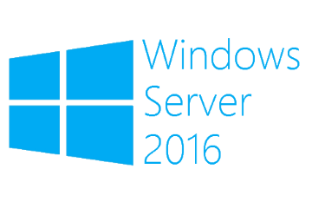
Cluster Aware Updating
Megaseries

Slide 2
Intro
New feature in Windows Server 2012
This feature helps you perform patches on your clusters without too much stress
Each node of the cluster is put in maintenance mode and updated while the other ones host the cluster resources
As a node is done with the updates it starts working normally and another one takes its place

Slide 3
Operation modes
Self updating mode (the update process is implemented as a cluster role on one of the nodes)
Remote updating mode (the update process is coordinated from another machine outside the cluster)

Slide 4
Update Sources
Sources for updates are accessed and updates are processed with Plugins
The 2 plugins available in CAU are:
WindowsUpdate Plugin
HotFix Plugin
The WindowsUpdate plugin uses the node’s configured update source
The HotFix plugin can be extended to support 3rd party updates like BIOS upgrades, drivers and so on; by default it installs msu, msi and msp files (made for LDR hotfixes)

Slide 5
Notes
If you will be using CAU please make sure that there are no other systems that schedule automatic updates on your cluster nodes like WSUS or SCCM
If CAU takes the updates from WSUS your cluster nodes should only be configured to point to the update server and that’s all; no automatic update settings please!
You can use both included plugins in the same update session
Read in detail: https://docs.microsoft.com/en-us/windows-server/failover-clustering/cluster-aware-updating

Slide 6

https://www.youtube.com/channel/UCcZ-jLbPwNr8E_v9-65n8Iw https://github.com/itknowledge4

